Slide 1
Divide & Conquer

Slide 2
Merge Sort

Slide 3
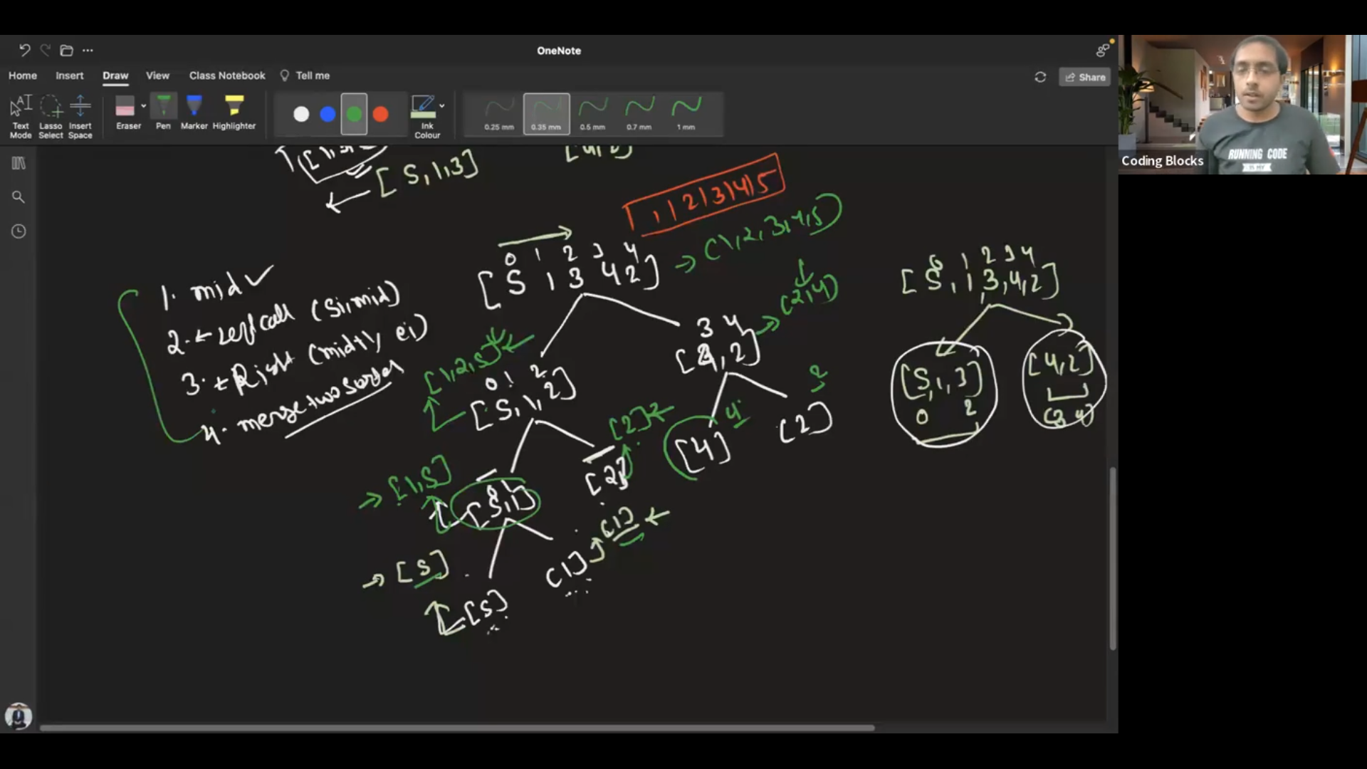

Slide 4
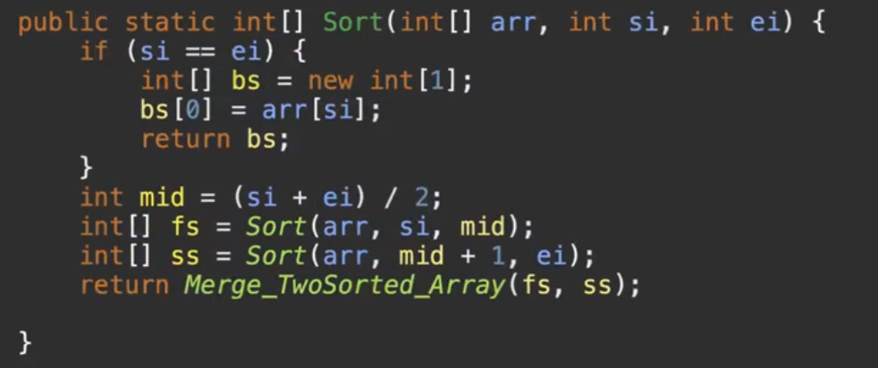
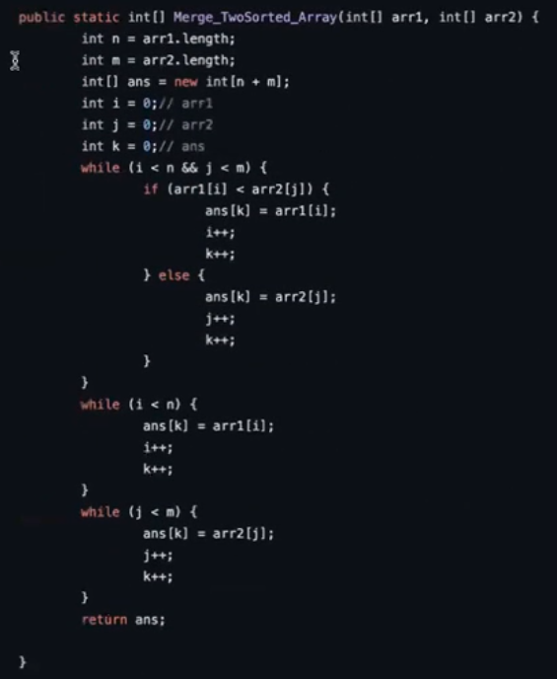

Slide 5
Quick Sort

Slide 7

